Slide 1
Learning
Chapter 4

Slide 2
Rote Learning
Rote learning refers to the memorization process by which facts or knowledge are memorized by repeated recital.
In artificial intelligence, the process can be applied to algorithms that remember data.
Volumes of data are handled by machines and stored for future reference.
For example, an AI model can remember a set of images so that it can identify similar images in the future.
Machines are able to remember information easily that has been learned, and this makes decision-making effective.
Therefore, it is restrictive, especially when applied to solve complex AI problems.

Slide 3
For example, it is essential in operations like pattern recognition, classification, and decision-making.
Rote learning-trained computers can identify objects in images or speech patterns.
Moreover, it is not sufficient for operations that require creativity or deep understanding.
In addition, rote learning in AI can only operate within the scope of memorized data.
While rote learning in AI has its strengths, it has several significant weaknesses. Its greatest weakness is that it cannot generalize.

Slide 4
For instance, rote learning-based AI models will not perform well on tasks outside the memorized data.
This is because rote learning does not lean toward deep learning or adaptation.
Rote learning-based AI models will not be able to handle new or unforeseen conditions well.
Additionally, memorization in AI can also lead to overfitting.
Overfitting occurs when a machine has learned the training data too well.
This hinders the machine from reacting to new, unseen data.
This is a very serious issue in the creation of AI because it limits the system to be inflexible.

Slide 5
Learning by Analogy
An analogy is essentially a bridge: it connects something we don’t fully understand to something we already know.
It’s a cognitive shortcut our brains love because it transforms abstract, complex ideas into something intuitive and relatable.
For example, comparing data packets traveling through a network to cars moving through city traffic instantly makes concepts like latency, congestion, and routing much easier to visualise.

Slide 6
When we grasp a concept by analogy, the brain performs something remarkable: it maps relationships from something familiar (the “source”) to something new or abstract (the “target”).
This process engages several key cognitive systems, including those responsible for reasoning, memory, and abstraction — effectively lighting up the mind as it builds connections between old and new ideas.
Specifically, it activates several processes in the brain:

Slide 7
Activation of associative networks
Analogies link two separate knowledge networks in your brain. For example, comparing electric current to water flow transfers your intuitive understanding of water (pressure, flow, blockage) to electricity, strengthening neural pathways for easier recall.
Pattern recognition and relational mapping
The prefrontal cortex and parietal regions handle holding both ideas in mind, identifying how relationships match, and focusing on structure rather than superficial details. When you say “the atom is like a solar system,” your brain maps the relationships, not the literal appearance.

Slide 8
Dopamine and the “Aha!” moment
When an analogy clicks, your brain releases dopamine, giving that satisfying “Aha!” feeling. This emotional reward reinforces learning and strengthens neural connections.
Integration into existing schemas
Analogies act as bridges, connecting new concepts to what you already know. Once the connection is made, the new idea can stand on its own in your mental framework.

Slide 9
Inductive Learning
Inductive Learning Algorithm (ILA) is an iterative and inductive machine learning algorithm that is used for generating a set of classification rules, which produces rules of the form “IF-THEN”, for a set of examples, producing rules at each iteration and appending to the set of rules.

Slide 10
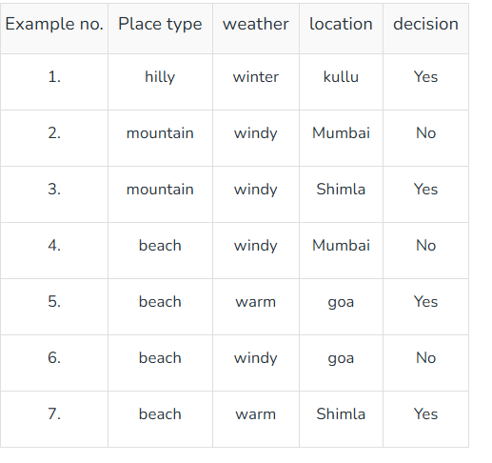
Example to generate ILA

Slide 11
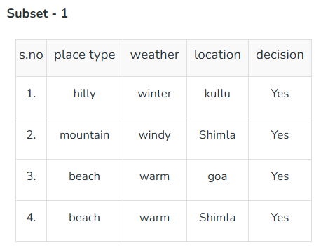

Slide 12
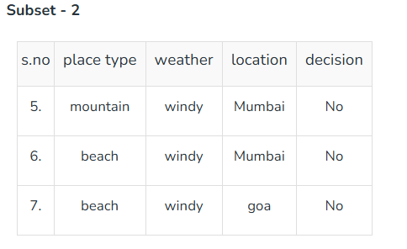

Slide 13
Explanation Based Learning
Imagine your mother says:
"Don't touch the hot pan."
You accidentally touch it once and It burns your hand.
Now you ask yourself:
Why did it burn?
Because the pan was hot. Now ,you don't memorize:
"That particular pan is dangerous."
Instead, you learn the rule:
Anything that is hot can burn me.
Next time, even if it's a different pan, kettle, or iron, you'll avoid touching it.
This is Explanation-Based Learning.

Slide 14
Explanation-Based Learning is a machine learning technique where an AI system learns by analyzing and understanding the underlying structure or reasoning behind a specific example.
Unlike traditional learning methods that require numerous examples to generalize, EBL leverages domain knowledge to form a general rule or concept from just one or a few examples.
This makes EBL particularly useful in domains where data is scarce or where understanding the rationale behind examples is more critical than just recognizing patterns.

Slide 15
How Explanation-Based Learning Works?
Explanation-Based Learning follows a systematic process that involves the following steps:
Input Example: The learning process begins with a single example that the system needs to learn from. This example is typically a positive instance of a concept that the system needs to understand.
Domain Knowledge: The system uses domain knowledge, which includes rules, concepts, and relationships relevant to the problem domain. This knowledge is crucial for explaining why the example is valid.
Explanation Generation: The system generates an explanation for why the example satisfies the concept. This involves identifying the relevant features and their relationships that make the example a valid instance.

Slide 16
Generalization: Once the explanation is generated, the system generalizes it to form a broader concept that can apply to other similar examples. This generalization is typically in the form of a rule or a set of rules that describe the concept.
Learning Outcome: The outcome of EBL is a generalized rule or concept that can be applied to new situations. The system can now use this rule to identify or solve similar problems in the future.

Slide 17
Supervised Learning
Supervised learning as the name suggests, works like a teacher or supervisor guiding the machine.
In this approach we teach or train the machine using the labelled data(correct answers or classifications) which means each input has the correct output in the form of answer or category attached to it.
After that machine is provided with a new set of examples (data) so that it can analyses the training data and produces a correct outcome from labeled data.
For example, a labeled dataset of images of Elephant, Camel and Cow would have each image tagged with either "Elephant", "Camel" or "Cow."

Slide 18
Example
Imagine we have a basket full of different fruits that we want the machine to identify. The machine first looks at the image of a fruit and extracts features like its shape, color and texture. Then it compares these features to the fruits it has already learned during training. If the new fruit’s features closely match those of an apple, the machine will predict that the fruit is an apple.
For example, suppose we train the machine by showing it fruits one by one:
If the fruit is round, has a small depression at the top and is red, it is labeled as an Apple.
If the fruit is long, curved and greenish-yellow, it is labeled as a Banana.
Now after this training, if we give the machine a new fruit (say a banana) from the basket and ask it to identify it, the machine will use what it has learned during training. It will analyze the shape and color of the new fruit and classify it as a Banana placing it in the correct category. In this way, the machine learns from the training data (the basket with labeled fruits) and applies that knowledge to recognize new, unseen fruits.

Slide 19
Types
Supervised learning is classified into two types of algorithms:
1. Regression
  A regression is used to predict continuous values such as house prices, stock prices or temperature. Regression algorithms learn how to connect input data to a specific number or value.
2. Classification
  A classification is used to predict categorical values such as whether a customer will buy or not, whether an email is spam or not or whether a medical image shows a tumor or not. Classification algorithms learn how to connect input data to the probability of belonging to different groups or categories.

Slide 20
Unsupervised learning
Unsupervised learning is a part of machine learning which works differently from supervised because there is no teacher(supervisor) involved to guide the machine.
In this approach the machine is given with data that has no labels or categories.
It analyzes the data on its own to find patterns, groups or relationships without any prior knowledge.
The machine learns by discovering hidden structures within the data without being told what the correct output should be.
For example, unsupervised learning can analyze animal data and group the animals by their traits and behavior.
These groups might represent different species which allows the machine to organize animals without any prior labels or categories.

Slide 21
Imagine we have a machine learning model trained on many unlabeled images of dogs and cats. The model has never seen any labeled example that says “dog” or “cat” before so it doesn’t know how these animals look like.
Now, if we give the model a new image that contains both dogs and cats it won’t be able to directly label them as “dog” or “cat.” It will group parts of the image based on similarities and differences in features like shape or texture. It might separate the image into two groups one with dog-like features and other with cat-like features.
This happens because unsupervised learning doesn’t rely on prior knowledge or training with labeled data. It finds patterns and organizes data on its own helps in discovering information that wasn’t given before.

Slide 22
Types of Unsupervised Learning
Unsupervised learning is divided into two categories of algorithms:
Clustering
  A clustering is used to group similar data points together. Clustering algorithms work by repeatedly moving data points closer to to the center of their group (cluster) and farther from points in other groups. This helps the algorithm to create clear and meaningful clusters.
2. Association rule learning
  An association rule learning used to find patterns and relationships between different items in a dataset. It looks for rules like “people who buy X often also buy Y”

Slide 23
Genetic Algorithm
Abstraction of real biological evolution and it is given by John Holland.
Focused on optimization means it take best solution among all solutions.
Solves complex problems. ( like NP hard problem)
Population of possible solutions for a given problem.
From a group of individuals, the best will survive.
Phenotype: raw solutions
Genotype: encoded raw solution.
encode
Phenotype
Genotype
decode

Slide 24
Initial Population
Calculate fitness
Selection
Crossover
Mutation
NO
Stopping criteria
yes
Optimal solution

Slide 25
Initial population: input must be diverse for eg for selection of candidate in election, the voter must be of different age. So if our population is diverse then our algorithm will work better.
Calculate fitness: function to calculate proper output according to input. For eg : if output is “take” and input is “make” then fitness value is 3 because 3 letters matches each other and similarly word “rat” the fitness function is 2.
Selection: it is directly proportional to fitness. Here we take two parent which have maximum fitness value and through that we create new population by using the method of crossover and mutation.
Crossover : there are various ways of doing crossover one of the method is one point.
  Foreg: parents can be “abcde” and “efghi”. Then randomly choose a point for eg 3rd point. Then swap value after 3rd point to make new population.
  After crossover the new population will be : “abchi” and “efgde”.
Mutation: the key idea is to insert random genes in generated offspring to maintain the diversity in population to avoid the premature convergence.
  Eg: abchi wil be after mutation abehi.

Slide 26
Then we will repeatedly perform this under we meet stopping criteria.
The stopping criteria is called convergence where the population fitness value is highest.
For eg: we have “Take” and our population is “kate” and “akte”. Then the fitness value is 4 in both case.

